Slide 1
Calculator History Using LinkedList
Under the supervision of Dr. Lamia Alrefaai

Slide 2

Prepared by:
Abdelrahman Salah El-dein Abdelaziz | 221903085
Farida Waheed Abd El Bary | 221903168
Mohamed Ahmed Mohamed Hassan | 221903120
Raneem Ahmed Refaat | 221903114
Razan Ahmed Fawzy | 221903165

Slide 3
Introduction
The program employs a Linked List data structure to manage the results of these operations, providing users with ideal access to their calculations. Notably, users can not only perform arithmetic but also view and delete previously stored results, enhancing the program's utility and user-friendliness.
This MIPS assembly program offers a comprehensive suite of arithmetic functionalities for floating-point numbers. Through carefully crafted algorithms, it executes addition, subtraction, multiplication,
and division operations with precision.

Slide 4
Code

Slide 5
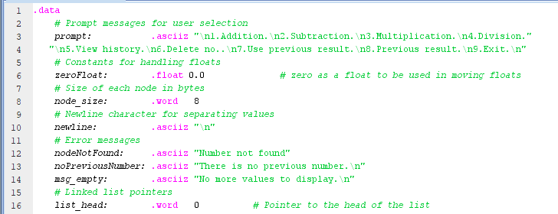




Data Definitions and Constants for Linked List Operations

Slide 6

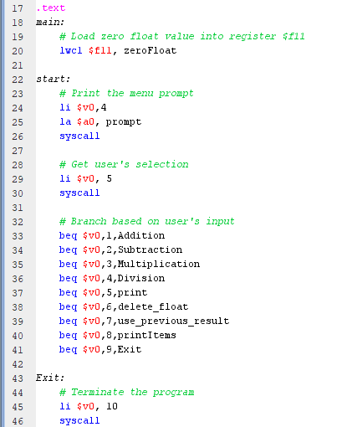
Main Control Flow and User Interaction

Slide 7
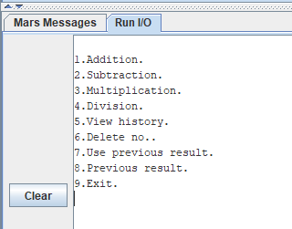
First when we run the program

Slide 8
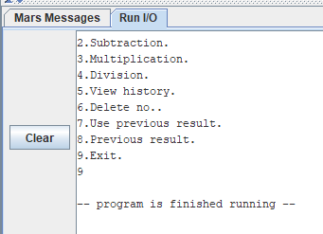
For 'Exit'

Slide 9
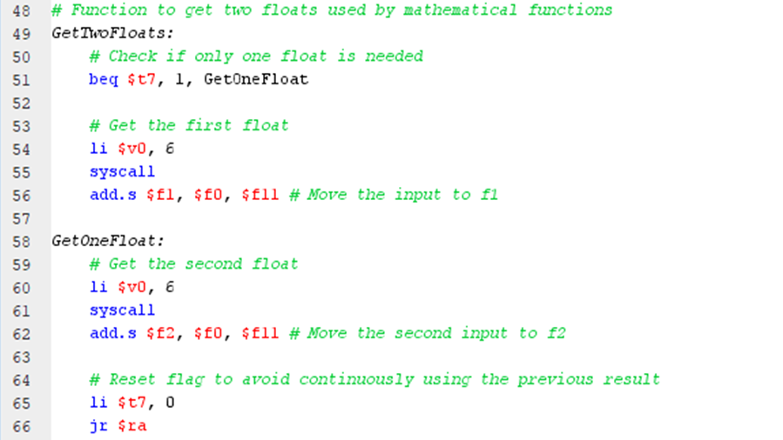
Float Input Handling in Arithmetic Operations

Slide 10
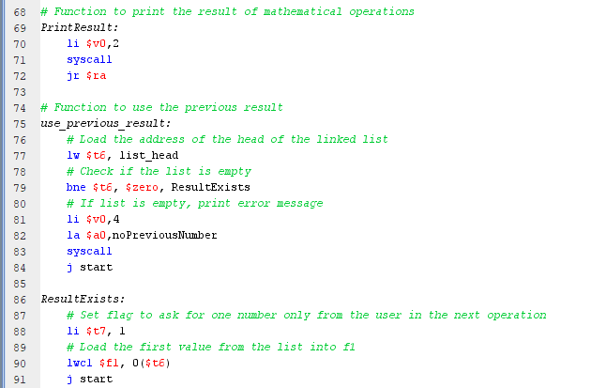
Result Display and History Recall

Slide 11
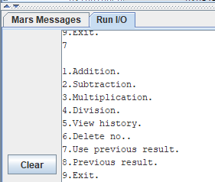
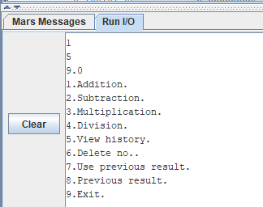
For 'Use previous result'

Slide 12
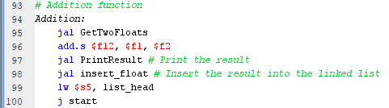
Addition Operation and Result Handling

Slide 13
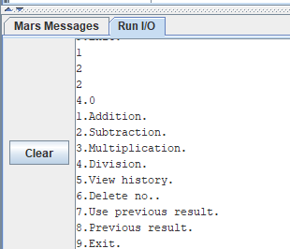
For 'Addition'

Slide 14
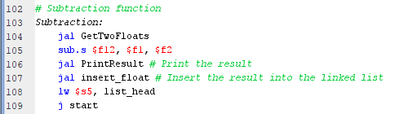
Subtraction Operation and Result Handling

Slide 15
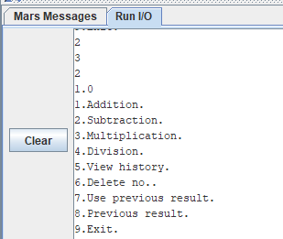
For 'Subtraction'

Slide 16
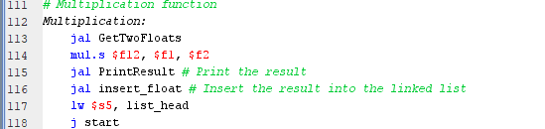
Multiplication Operation and Result Handling

Slide 17
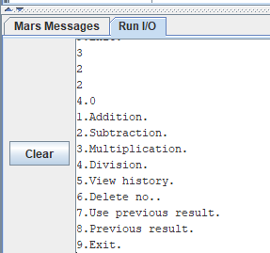
For 'Multiplication'

Slide 18
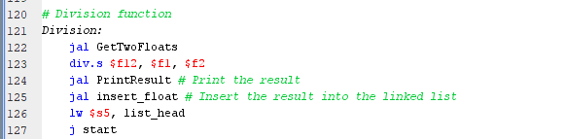
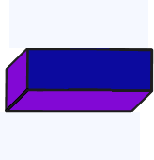
Division Operation and Result Management

Slide 19
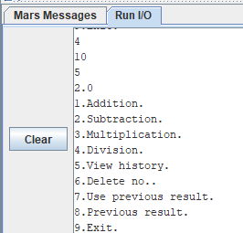
For 'Division'

Slide 20
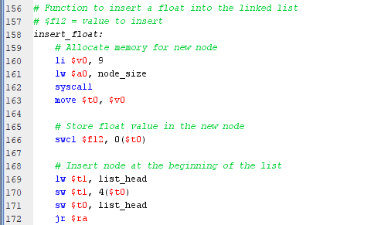
Linked List Float Insertion Function

Slide 21
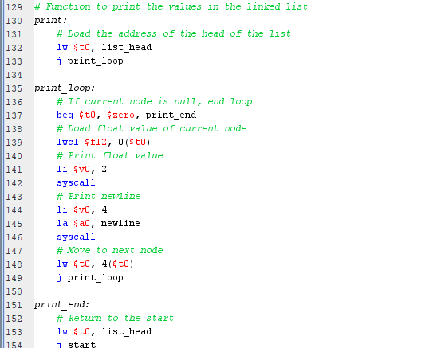
Linked List Printing Functionality

Slide 22
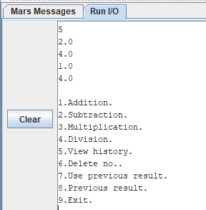
For 'View history'

Slide 23
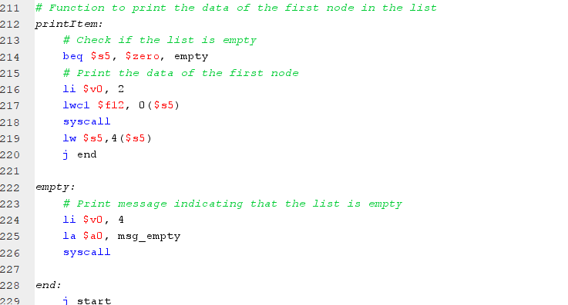
Node Data Printing Function

Slide 24
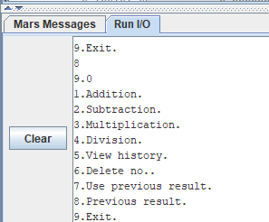
For 'Previous results'

Slide 25
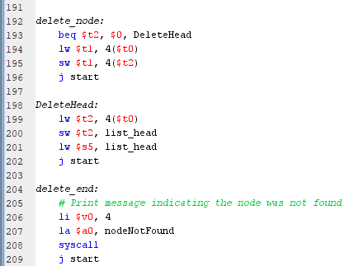
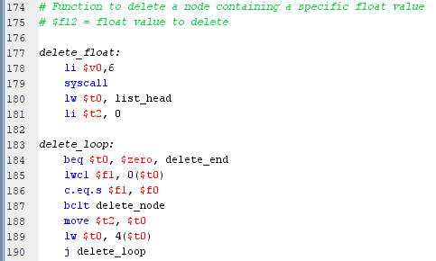
Linked List Float Deletion Function

Slide 26
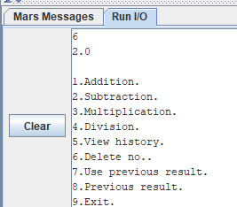
For 'Delete no.’ in case “existing num”

Slide 27
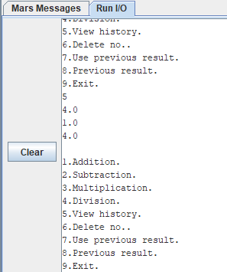
Then choose'View history'

Slide 28
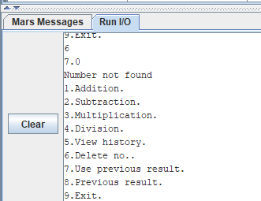
For 'Delete no.’ in case “not existing num”

Slide 29

Thank You☺!

